Slide 1
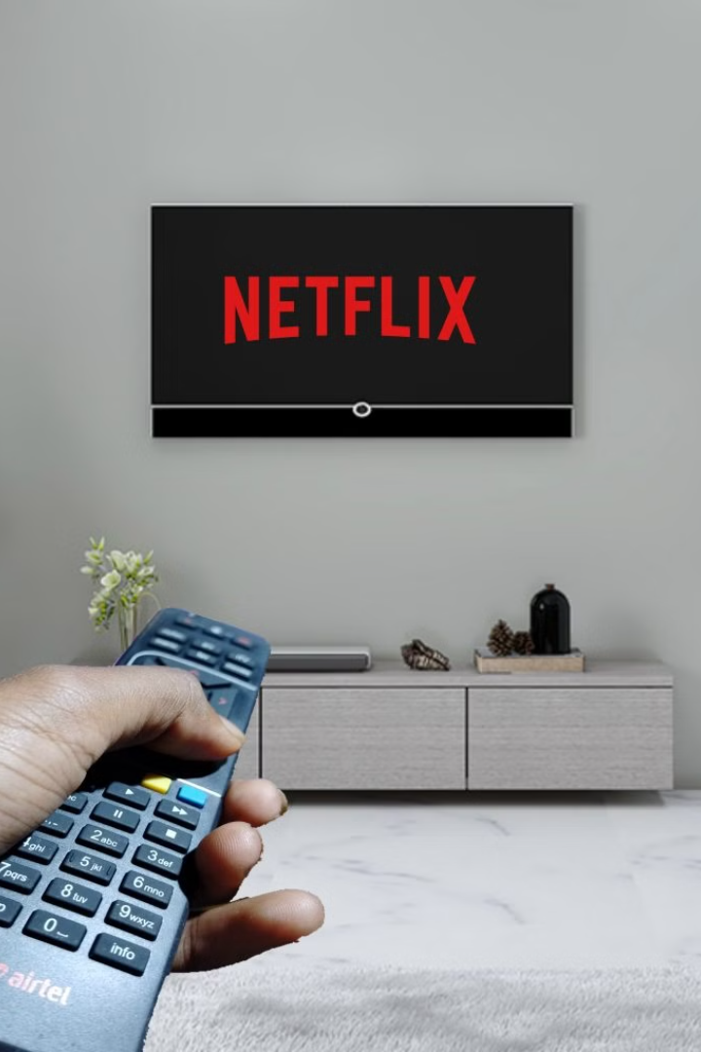

Netflix System Design: Simple Breakdown
Netflix System Design can feel complex, but let's break it down into simple, easy-to-understand terms. Think of Netflix as a giant machine designed to let you watch movies and shows anytime, anywhere, on any device. Here's how it works step by step:
by Ram N Java

Slide 2
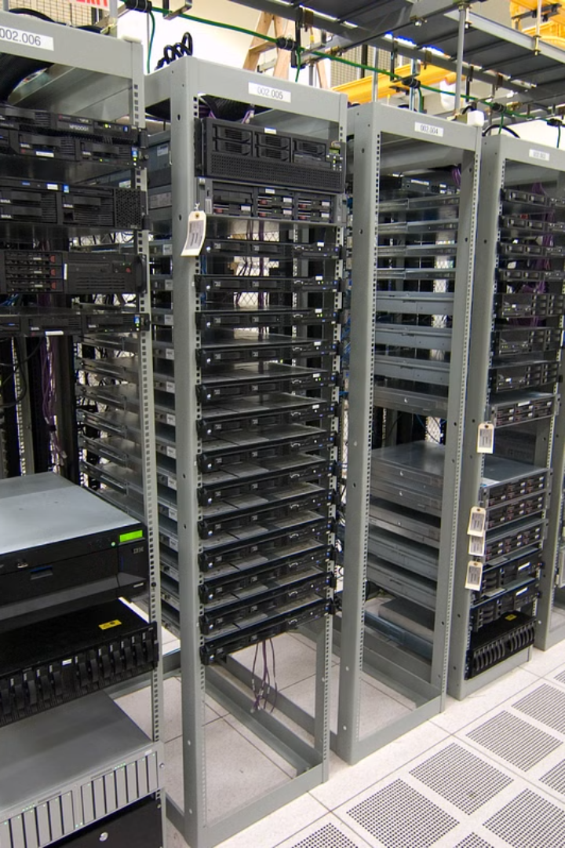
Content Storage
1
Huge Library
2
Compressed Storage
Netflix has a huge library of movies, TV shows, and documentaries. These are stored in data centers or on cloud storage systems like AWS (Amazon Web Services).
All the videos are saved in high quality but are compressed to take up less space and stream faster.

Slide 3

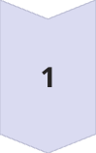
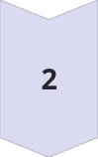
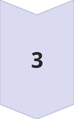
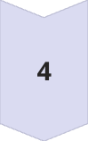
Content Delivery Network (CDN)
Global Server Network
When you hit "Play," Netflix uses a network of servers around the world, called a
Content Delivery Network (CDN), to deliver the video.
Local Delivery
Instead of sending it from one central place (which could be slow), the video comes from
a server close to your location.
Benefits
Faster streaming
Less buffering
Open Connect
Netflix also uses its own CDN called Open Connect to control and optimize this process.

Slide 4
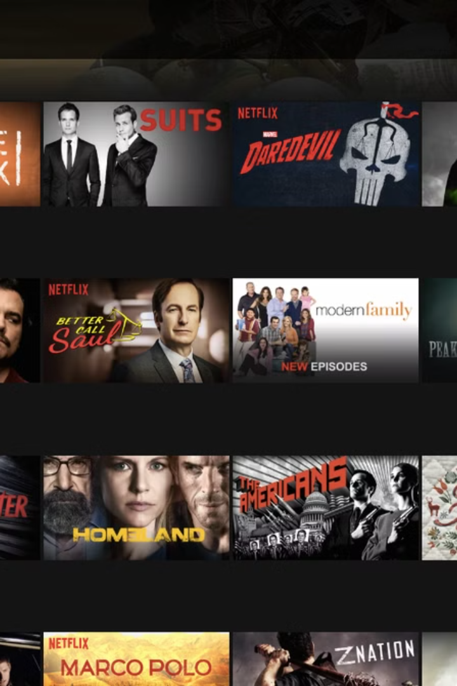




Personalization and Recommendations
AI and Machine Learning
Tracking Preferences
Netflix uses AI (Artificial Intelligence) and Machine Learning to recommend shows and movies you might like.
Tracks what you watch.
Analysis
Recommendations
Analyzes your preferences.
Shows similar content. For example, if you love action movies, Netflix will suggest more action-packed titles!

Slide 5
Streaming Process
Data Packets
Benefits
When you play a video, Netflix delivers it in
small chunks called data packets.
Videos start quickly without loading the entire file.
It adjusts the video quality based on your internet speed (HD, 4K, etc.).

Slide 6
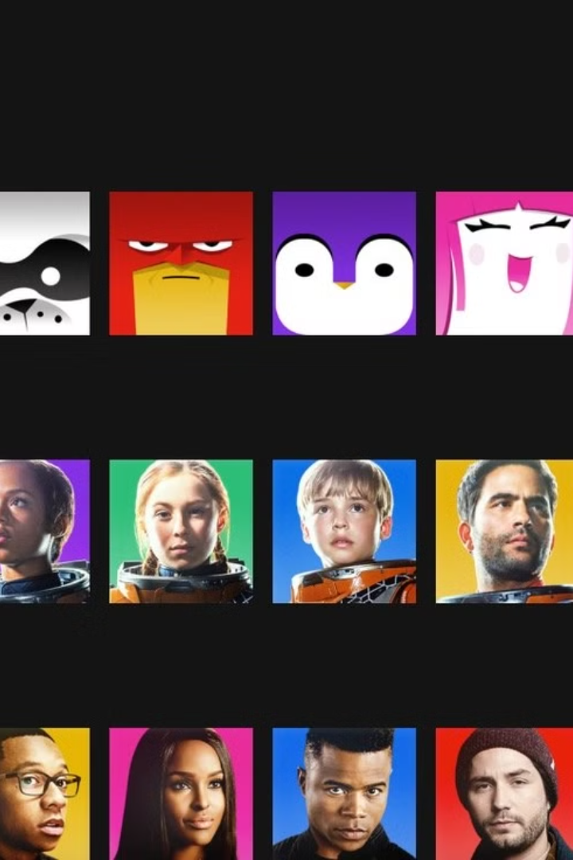
User Accounts and Profiles
Multiple Profiles
Profile Storage
Netflix allows multiple profiles under one account.
Each profile stores:
Preferences (e.g., genres you like)
Watch history
Personalization
This makes Netflix feel personalized for each user.

Slide 7



Scalability
1
Millions of Users
Cloud Computing
2
Handles sudden increases in traffic
Distributed Servers
3
Worldwide for reliability
Netflix has millions of users. To ensure the service works smoothly for everyone:
It uses cloud computing to handle sudden increases in traffic (like during a new show launch).
Servers are distributed worldwide for reliability.

Slide 8
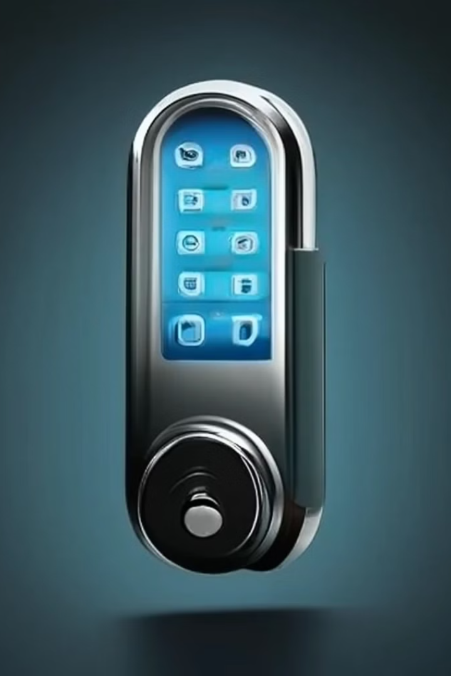


Security Measures
Netflix protects your account and data using:
Encryption
DRM
To secure videos and passwords.
Digital Rights Management to prevent unauthorized copying or sharing of content.

Slide 9
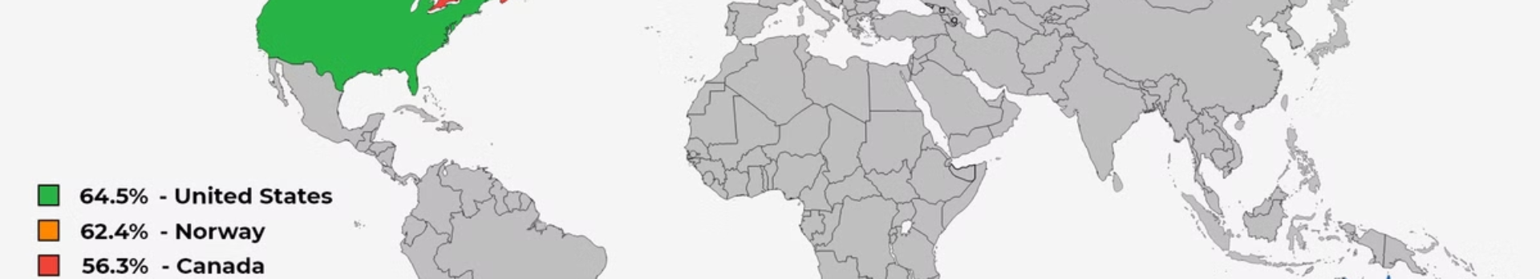
Global Availability
190+
Multiple
Countries
Languages
Netflix is available in over 190 countries.
Content is stored in multiple languages.
To achieve this:
Content is stored in multiple languages.
Servers are distributed globally for faster streaming.

Slide 10
Netflix as a Pizza Delivery System
Example in Real Life: Imagine Netflix as a pizza delivery system:
Movies and Shows
Data Centers
CDNs
Streaming Process
The movies and shows are the pizzas.
The data centers are the kitchens.
The CDNs are delivery hubs close to your home.
The streaming process is the pizza being delivered hot and fresh to you.

Slide 11
Netflix System Design Benefits
Fast, Reliable Streaming
Personalized Experience
Fast, reliable streaming for millions of users.
Personalized experience for everyone.
Seamless Scaling
Seamless scaling during high demand (like during popular releases).

